Slide 1
Windows Operating system

Slide 2
Windows OS
Is a series of software operating system and graphical user interfaces produced by Microsoft.
Had approximately 91% of the market share of the client operating systems for usage in the internet.

Slide 3
First introduced an operating environment named Windows in November 1985 as an add-on to MS-DOS in response to the growing interest in graphical user interfaces.

Slide 4
History of Windows OS
Microsoft Windows was announced November 10, 1983.
Microsoft Windows 1.0 is introduced in November 20, 1985.
Microsoft Windows 2.0 was released December 9, 1987.
Microsoft Windows/386 or Windows 386 is introduced December 9, 1987.

Slide 5
Microsoft Windows/286 or Windows 286 is introduced June, 1988
Microsoft Windows 3.0 was released May, 22 1990. Microsoft Windows 3.0 full version
Following its decision not to develop operating systems cooperatively with IBM, Microsoft changes the name of OS/2 to Windows NT.

Slide 6
Microsoft Windows 3.0 or Windows 3.0a with multimedia was released October, 1991.
Microsoft Windows 3.1 was released April, 1992 and sells more than 1 Million copies within the first two months of its release.

Slide 7
Microsoft Windows for Workgroups 3.1 was released October, 1992.
Microsoft Windows NT 3.1 was released July 27, 1993.
The number of licensed users of Microsoft Windows now totals more than 25 Million.
Microsoft Windows for Workgroups 3.11 was released February, 1994.
Microsoft Windows NT 3.5 was released September 21, 1994.
Microsoft Windows NT 3.51 was released May 30, 1995.
Microsoft Windows 95 was released August 24, 1995 and sells more than 1 Million copies within 4 days.

Slide 8
Microsoft Windows NT 4.0 was released July 29, 1996.
Microsoft Windows CE 1.0 was released November, 1996.
Microsoft Windows CE 2.0 was released November, 1997.
Microsoft Windows 98 was released June, 1998.
Microsoft Windows CE 2.1 was released July, 1998
In October of 1998 Microsoft announced that future releases of Windows NT would no longer have the initials of NT and that the next edition would be Windows 2000.

Slide 9
Microsoft Windows 98 SE (Second Edition) was released May 5, 1999.
Microsoft Windows CE 3.0 was released 1999.
On January 4th at CES Bill Gates announces the new version of Windows CE will be called Pocket PC.
Microsoft Windows 2000 was released February 17, 2000.
Microsoft Windows ME (Millennium) released June 19, 2000.
Microsoft Windows XP is released October 25, 2001.
Microsoft Windows XP 64-Bit Edition (Version 2002) for Itanium systems is released March 28, 2003.

Slide 10
Microsoft Windows Server 2003 is released March 28, 2003.
Microsoft Windows XP 64-Bit Edition (Version 2003) for Itanium 2 systems is released on March 28, 2003.
Microsoft Windows XP Media Center Edition 2003 is released on December 18, 2003.
Microsoft Windows XP Media Center Edition 2005 is released on October 12, 2004.
Microsoft Windows XP Professional x64 Edition is released on April 24, 2005.
Microsoft announces it's next operating system, codenamed "Longhorn" will be named Windows Vista on July 23, 2005.

Slide 11
Microsoft releases Microsoft Windows Vista to corporations on November 30, 2006.
Microsoft releases Microsoft Windows Vista and Office 2007 to the general public January 30, 2007.
Microsoft releases Windows 7 October 22, 2009.

Slide 12
Versions of Windows Operating System
Version 1
Version 2
Version 3
Version 3.1
Version 3.11
Version 3.11WfW
OS/2 1.0
OS/2 2.0
OS/2 2.1
NT 3.1
NT 3.5
OS/2 Warp
Version 95
NT 4.0
Version 98
Windows 2000
Windows XP
Windows XP SP 1
Windows XP SP 11
Windows Vista
Windows Server 2008
Windows 7

Slide 13
Advantages
Easy to Use
Update
Supporting
Gaming
Familiar

Slide 14
Disadvantages
Expensive
Not stable
Not secure

Slide 15
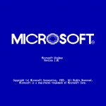
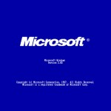
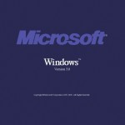
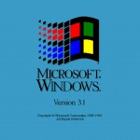
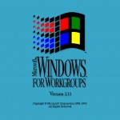
Microsoft Windows 1.01 (1985) Logo – Notice the original Microsoft logo.
Microsoft Windows 2.03 (1987) Logo –
Microsoft changes their logo for an italicized and bold look
Microsoft Windows 3.0 (1990) Logo
Microsoft Windows 3.1 (1992) Logo

Slide 16
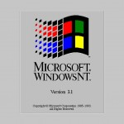
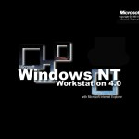
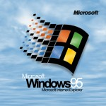
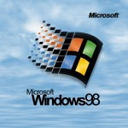
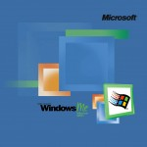
Microsoft Windows 3.11 (1993) Logo
Microsoft Windows NT 3.1 (1993) Logo
Microsoft Windows 95 (1995) Logo
Microsoft Windows 98 (1998) Logo
Microsoft Windows ME (2000) Logo

Slide 17
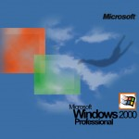
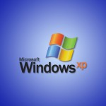
Microsoft Windows 2000 Professional (2000) Logo
Microsoft Windows Longhorn Logo
Microsoft Windows 2003 Logo
Microsoft Windows XP (2001) Logo

Slide 18
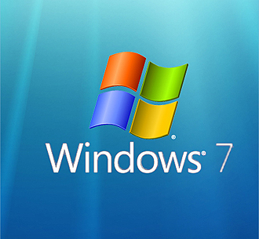
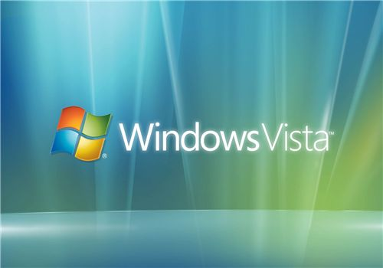
October 22, 2009
Windows 7
Windows 7 is the current major release after Windows Vista and was planned for a three-year development timeframe. It was previously known by the code-names Blackcomb and Vienna.
Qualifying for the "Certified for Windows Vista" program lets your customers know that your products provide a high quality Windows Vista experience. When customers see the logo displayed online and on your products, it helps them instantly recognize that your products have met a high standard of reliability, security, and compatibility

Slide 19
or malicious program can cause corruption. Advantages: DOAS is very lightweight and it allows direct access to most hardware. It does not have the overhead of a multitasking operating system. Disadvantages: It is 16-bit and limited to 640k of RAM (this can be overcome with a DOS extender) It runs in real mode, so a buggy

Slide 20
Advantages
Light
easily available
Disadvantages
Its a Single User OS (One User can Work at a time)
Its a Single Tasking OS (One application can run at a time)
It does not supports Graphics
It does not supports Networking
We can only make 2GB of Maximum partition as it supports only FAT 16.

Slide 21
Windows by Future IT
Thank you…

Slide 22
?

